Slide 1
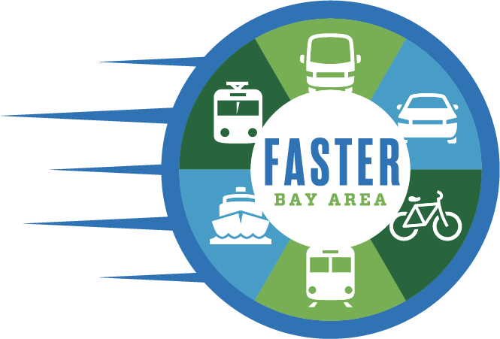
A FASTER Bay Area
A Seamless Transportation System Based On:
Freedom
Affordability
Speed
Transparency
Equity
Reliability
Notes:
ARIELLE
Here talk about something that we think is really exciting: FASTER Bay Area. It’s both a concept-- that we need to transform our regional transit systems if we’re going to be able to deliver the mobility and the equity and and affordability sustainability we need across the entire region -- and it’s also a board coalition we’ve organized to make that happen. Coalition of business group, also of labor, community, equity and environmental groups and other stakeholder groups and it’s continually growing to address our region’s transportation problem and congestions problems and make our transportation system more integrated and seamless
I’l tell you a bit today about where we are and really appreciate the input. This is about doing something transformative for all parts of the bay area.
FBA is a vision for a seamless transportation system based on ...

Slide 2
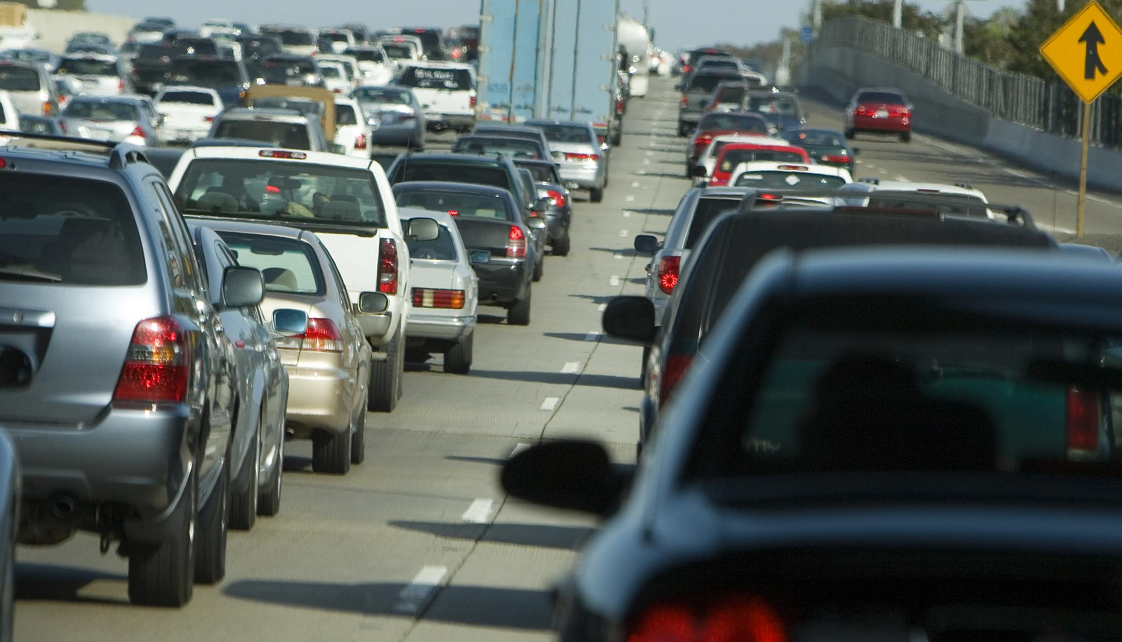
The Bay Area Today
The Bay Area is home to one of the most dynamic economies in the world.
However, the region's infrastructure is based on pre-1960's models unable to keep pace w/ population & economic growth.
Commute times are crippling the Bay Area economy and productivity, causing residents to lose 116 hours annually to their commute.
Notes:
ARIELLE
READ Slide.
Commute times are increasing, mobility is decreasing, transit ridership is down. 46 % of respondents in a recent poll stated they are considering leaving the region all together.

Slide 3
Key Public Opinion Research Findings
Residents recognize the transportation challenges facing the region
Voters are seeking a modern, reliable, and accessible transit system that connects the Bay Area
Conceptual willingness to raise taxes for transportation investments is above two-thirds
Differences in support between funding mechanisms are slight, and within the margin of error
A regional measure is viable in the right environment; however, organized and funded opposition will likely result in defeat
Notes:
ARIELLE
We wouldn’t want to embark on something like this without understanding public opinion and here are some of the highlights from that.
There is significant interest in a solution of this scale.
The whole bay area
At above the ⅔ threshold level that would be required.
We tested a number of different revenue raising mechanisms and the difference in support between them are slight and within the margin of error. Which leads us to conclude that a major regional measure to transform our regional transportation system is politically … but organized and funded op could end in defeat.
MORE on sales tax:

Slide 4
FASTER Principles
Prioritize the development and implementation of a true regional transit system
Provide freedom of access, mobility, and a true alternative to driving alone
Solve for existing barriers - including affordability, speed, reliability, and ability to access the system
Support economic development: transit allows new areas for housing and business development throughout the 9 counties
Reduce climate emissions and adapt to a changing environment
Notes:
ARIELLE
Based on outreach work we’ve done-- which we will talk about more later -- we’re starting to settle on a number of principles necessary to transform our regional transportation network.
-- This new system has to faster than driving along and more reliable. Which basically means it have to be out of traffic and frequent. We need to be freed from the tyranny of schedules which means you won’t be late to getting kid or picking up a parent.
- ability to access for everybody universal access… as well as access for pedestrians and bicyclists, access for low income communities that are so often excluded from transit planning.
New areas for affordable housing
We need to center equity in our new vision for the future of regional transportation. Prioritizing access to vulnerable communities as well as planning to stabilize those communities before we make major transit investments.
It means adopting universal design and accessible standards for the
It needs to be a vision that is regional, but also community focused, with deep community engagement in funding allocation decisions.
To do this -- we need to resource existing transit agencies not just with funds to build projects but to operator them and also to increase their own capacity to deliver transformation at this scale
And of course, sustainable. Transportation is the fastest growing source of emissions in the state of CA. We need to have a system which is clean. These investment should be significantly reducing VMT.
We’re trying to achieve what local measures cannot by generating funds to support integrating the system across jurisdictional boundaries.
Want the system to be more reliable → and accessible to populations not currently served or served adequately by transit and make it more affordable as well.
Funds to adress emission and hve funds for reilliance and adaption.

Slide 5
Leadership Group Vision
Bay Area residents deserve a world-class, integrated, seamless transit system that connects and extends BART, Caltrain, the Altamont Commuter Express, SF Muni, VTA Light Rail, SMART, Amtrak, the Capitol Corridors, Ferries, Bikes and buses; to provide reliable, safe and efficient service for those who are transit dependent, and compelling enough to lure those of us who are current car commuters out of our automobiles.
Notes:
Nick

Slide 6
Outreach Touch Points
Recurring Meetings
Operators and County Transportation Agencies
MTC
Local Transportation Leaders and Stakeholders
Business Leaders
Equity and Transit Coalition
Labor
Environmental Groups
Public Outreach
Outreach forums in fall 2019
Board presentations
Survey
Notes:
KELLI
To help inform our process, we’ve had meeting with …
also doing public outreach. Doing public outreach…. Alameda couty in …. Soon releasing a survey for the public to weigh in on the measure.

Slide 7
Feedback from Outreach to Date
Focus on transit
Integrate public transit system into one fast, user-friendly system
Regional express buses running on fast express lanes
Discount fares
Walk and bicycle access
Use emerging mobilities to provide flexible transportation
Funding for climate adaptation
Notes:
KELLI

Slide 8
Funding Mechanism
Based on our research, the One Cent Sales Tax generated substantial funding, has the flexibility to fund operations, is politically viable, and is a funding source that has historically garnered broad support for transportation investments in the Bay Area.
It is expected to generate $100.6 billion over 40 years.
Notes:
KELLI
Enough funding to make a transformation differnece

Slide 9
Funding Mechanism
Pros
Use of proceeds are not restricted and straightforward tax that voters understand
The revenue is sufficient to fund a long-term strategic plan for capital improvements and operating budgets
Bay Area employers contribute significantly in sales tax, with more than 35 percent of sales tax paid by businesses (roughly $550 million annually from this measure)
Sales taxes are not paid on three big expenses: housing, health care and groceries
Cons
Regressive
Other sales taxes may go to the same ballot, though it is not clear what the impact would be
Notes:
From Nick.
Restricted like a bond measure would be
Budgets… that would transform our regional transportation system. BUT it’s not enough to fund everybody’s project. It turns out that 100 billion doesn’t actually buy you as much transit investments as you would think it would in the bay area. It’s also not just a question of just building projects… it’s really a question about centering equity, about achieving seamless transit, and integrating disparate transit networks. It’s about building projects and also making the policy changes and changing how we plan and operate our entire network so we can actually deliver the mobility that we need.
Regressivity is something we take very seriously. I wanted ground it in some numbers and tell you a little bit about the steps were taking to address the regressivity
The cost of a one-cent sales tax to low-income household, those that are on the bottom quintile of the income scale, would be less than $10 a month. Which is not insignificant. One of the solutions that we’re thinking about is putting in place a low income sales tax credit. this would be the first time its been done in CA; it’s been done in a number of other states including Hawaii and elsewhere… where low income would get a refundable tax credit equivalent to the estimated amount they would spend in additional sales taxes, to keep them whole. On average if you take all sales and excise taxes paid by low-income families in CA, they pay 8% of their annual income in excise taxes. If we could pilot a mechanism through this measure, we could create a roadmap to significantly reduce that burden on low-income households I think that would be a tremendous equity move.
Also committed to rolling out a deep and in perpetuity affordable fares program. If we could put in place a significant means based discount for low-income families, that would make a huge difference. That could have benefits of up to 40/50 a month per person who takes transit during the commute.
We’re also very much focused / thinking though with large employer in the region the possibility of a region wide TDM program. Requires employers to invest in the commutes of their workers and could we structure this is such a way that they’re required to invest in the commutes of their low -income and moderate wage workers… looks like everything from things like bike share memberships, transit passes to incentives to vanpool or carpool incentives… would look different in different contexts. Deploying a region wide program is something that could really help drive people on to transit and provide the right incentives for people to make the right decisions in their commute and also is a way for large employers to contribute even more to solving our regional transportation problems
Also trying to get at the regressivity through the expenditure plan. We’re very committed for this to be a transit measure. As you all know, low income communities are the disproportionate users of transit.
Committed to prioritizing access for communities of concerns as well as protection for vulnerable residents. And committed to an inclusive decision making process

Slide 10
Process

Slide 11
Next Steps
Exploring rebates, affordable fares, and other options to address regressivity
Defining longer-term vision as well as key projects that are shovel ready
Can you help us? We are looking for support with projects, programmatic ideas, and/or FASTER outreach?
Info@FASTERBayArea.org

