Slide 1
25th Avenue
Grade Separation
March 1, 201

Slide 2
Overview
Purpose & Scope
Schedule and Estimate
Coordination with Electrification
ROW Needs
2

Slide 3
Purpose & Scope
Improve safety by constructing a Grade separation at 25th Avenue, along with elevated rail between Hillsdale and Highway 92
Relocate Hillsdale Station and provide station access and parking
Construct new East-West connections at 28th and 31st Avenues
3

Slide 4
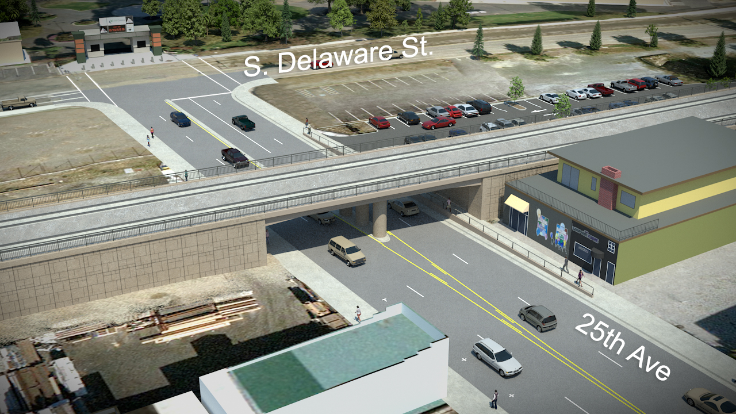
Grade Separation (25th Ave)
4

Slide 5
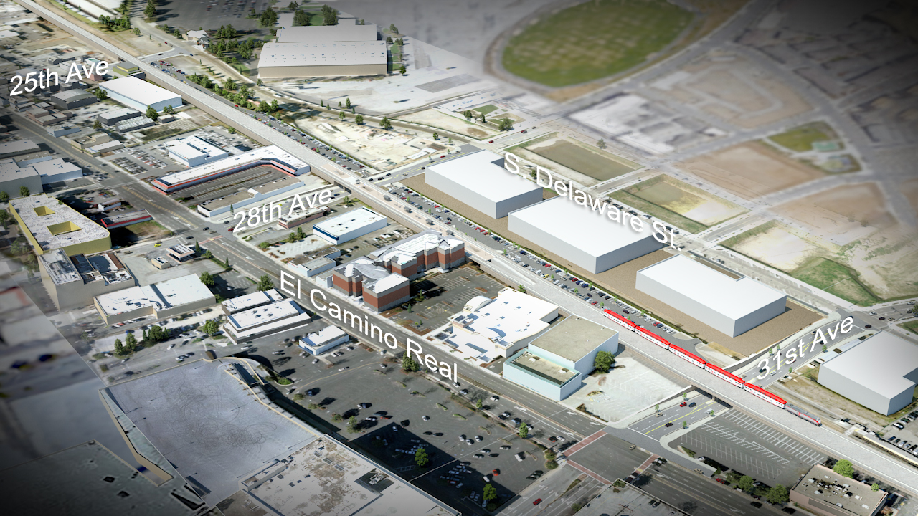
Elevated Track
5

Slide 6
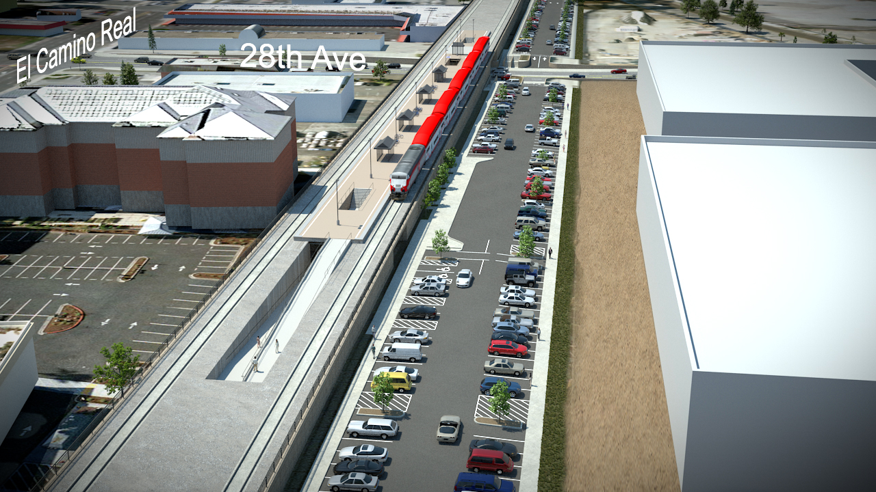
Relocated Hillsdale Station
6

Slide 7
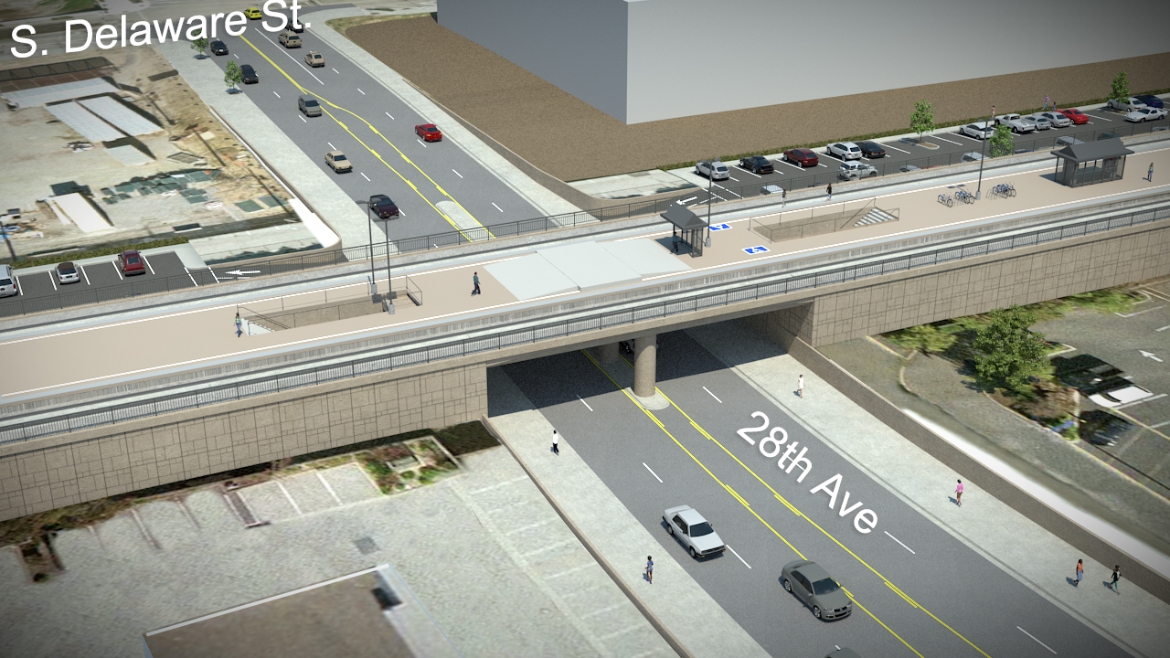
East-West Connection (28th Ave)
7

Slide 8
Schedule and Estimate
Activity | Date
Environmental | Jan. 2015 – Aug. 2016
Design & ROW | Jan. 2015 – Dec. 2016
Bid & Award | Dec. 2016 - May 2017
Construction | June 2017 - Dec. 2019
Project Estimate $ 180.0 M
8

Slide 9
Coordination w/ Electrification
Project is building the foundations (but not poles and wires) for the Electrification Overhead Contact System (OCS)
Construction of grade separation needs to start by summer of 2017 to be completed before the installation of the OCS
9

Slide 10
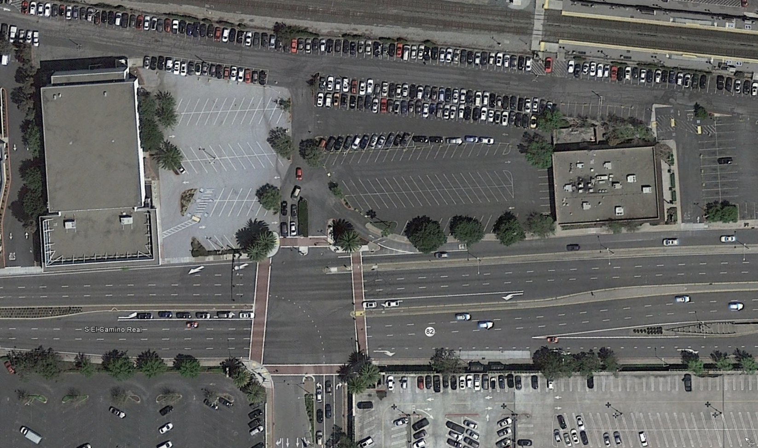






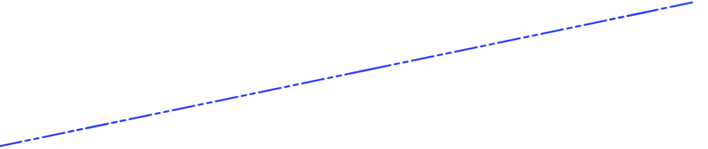
ROW Needs

Slide 11
Questions
11

